Slide 1

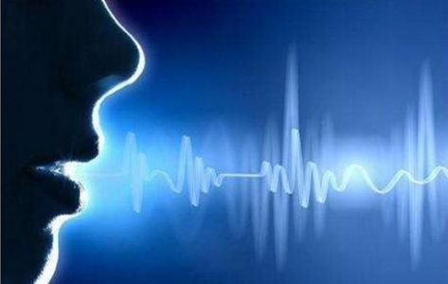
Hello Edge: Keyword Spotting
on Microcontrollers
Yundong Zhang①②,
Naveen Suda①,
Liangzhen Lai①,
Vikas Chandra①
①Arm,San Jose,CA
②Stanford University,Stanford,CA
arXiv:1711.07128v3 [cs.SD] 14 Feb 2018
Notes:
1. 知名的研究机构，ARM, 斯坦福大学
2. 边缘，单片机，语音识别；

Slide 2

Why to select this one from papers?
1. Edge computing
gateway(soc, eg. honeywell JACE,raspberrypi),
device(mcu, eg. stm32)
2. ARM machine learning project
CMSIS-NN code for microcontrollers.
3. Pattern Recoginition, keyword spotting
critical component for enabling speech based user interactions on smart devices, for example, door lock.
4. small data feature, litte sample
a research direction of AI.
Notes:
选论文的原因，
1.阿里最新战略，云-管-边-端；
2.ARM公司对ML的最新研究；arduino(stm32),raspberrypi这样的低廉的测试床
3.模式识别，关键词检测之于门锁这样的嵌入式系统的意义（高端，低端）；
3.小数据，小样本是AI的新热点；

Slide 3
Abstract
1.Keyword spotting(KWS),
a critical component , real-time response and high accuracy
2.neural networks
an attractive choice for KWS because of superior accuracy compared to traditional algorithms.
3.Resource constrained
constrained power budget, limited memory and compute capability.
4.neutral networks evaluation/optimisation
KWS within the memory and compute constraints of microcontrollers without sacrificing accuracy.
5.depthwise separable convolutional neural network(DS-CNN)
higher accuracy than the DNN model with similar number of parameters.
2016-2017 published
Notes:
1. 语音关键词检测对于设备上的语音识别应用非常重要，实时响应和高精度；
2. 基于神经网络的关键词检测比较传统的算法有更好的准确性；
3. 资源，包括能量开销，有效内存和计算能力，对关键词检测和NN架构有新的调整；
4. 文章中对各类KWS在单片机这样有限资源的设备上进行评估，并没有牺牲精确度；
5. DS-CNN比DNN模型有更好的精度；

Slide 4
I. Introduction
II. Background
CONTENTS
III. Neural Network Architectures for KWS
IV. Experimental and Results
V. Conclusions

Slide 5
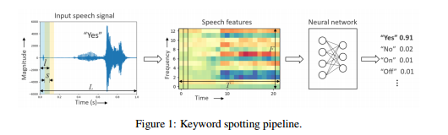
I. Introduction
service(include AI) migration
from cloud to edge or terminal
1. latency of communication with cloud
2. privacy concern
Notes:
1. 深度学习现在在图像识别，语音识别等领域已经有很好的应用；
2.基于深度学习的语音识别很自然成为了一个比较好的人机交互方法；
3.一般来说AI算法都运行在云端，设备端主要做信号采集与传统的信息处理，所以需要上次audio数据；
4. 上传audio数据可能带来隐私问题；
5. KWS目的是减少与云的交互，将部分语音识别放在设备端或者边缘端；
6. KWS之后才是完全唤醒设备和激活全功能的语音识别功能；从而为声音控制命令；
7.挑战性问题，低功耗和低延时的，所以50年来一直是一个比较活跃的研究领域；

Slide 6
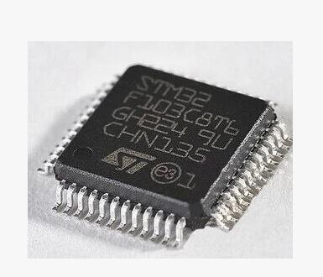
I. Introduction
low power consumption requirement for keyword spotting systems,
select mcu,
hardware/embedded system
low cost,low energy, low size,
digital signal processor,
microcontroller, cortex-m, stm32,
system of chip, cortex-a, raspi,
software/nn
https://github.com/ARM-software/ML-KWS-for-MCU
challenges and contributions
train KWS nn model
new KWS using depth-wise separable convolutions and point-wise
inspired by MobileNet
resource-constrained nn
Notes:
1. 前一页讲了典型语音识别系统框架，框架是框架，工程是工程，本文基于一个门锁所用的芯片stm32f7系列的芯片搭建这样的测试testbed；
2.训练KWS模型，对现有的KWS进行优化；
3.设计和实现或探索自己的资源受限的nn网络；

Slide 7
II. Background
Keyword Spotting (KWS) System
a feature extractor and a neural network based classifier
Input speech signal parameters
L: signal length
l : overlapping frame length
s: stride length
T: frame number
F: speech feature number per frame
LFBE and MFCC
common for human-engineered speech feature
feature extraction , time-domain speech signal into a set of frequency-domain spectral coefficient
dimensionality compression
Classifier
Neural Network
traditional speech recognition for KWS：HMMs and Viterbi decoding
Notes:
1. KWS包括特征提取和基于神经网络的分类器；
2. L,T,l,s,F的定义，相互关系；
3. LFBE Log-mel filter bank engergies
4. MFCC 梅尔倒谱系数；
5. 分类器，包括NN，传统的有隐马尔科夫链，维特比解码，当然还有采用混合高斯模型对语音特征进行建模的
6. RNN明显比HMM方法检测精度高，但是有比较大检测延迟
7. DNN效果好，延时要小一点。
8. CRNN的KWS被研究，对噪音的鲁棒性很好
9. 本文主要关注在受限资源，包括内存，计算，通信，能量等。

Slide 8
II. Background
Microcontroller Systems
processor core
SRAM
flash
Characteristics
Low-cost and high-energy efficient
Low compute ability
So, some improvement
Intergrated DSP instuctions
SIMD
MAC
Arm Mbed platform | processor | frequency | SRAM | Flash
STM32F103CBT6 | Cortex-M3 | 48MHz | 20K | 128K
STM32L431RCT6 | Cortex-M4 | 80MHz | 64K | 256K
STM32L471RET6 | Cortex-M4 | 80MHz | 128K | 512K
Nucleo F746ZG | Cortex-M7 | 216MHz | 320K | 1M
Notes:
1. SIMD single instruction multiple data 同时读取数据，一次执行
2. 乘法和加法

Slide 9
III. Neural Network Architectures for KWS
Different neural network
DNN
CNN
RNN
CRNN
DS-CNN
Notes:
1. 不同神经网络

Slide 10
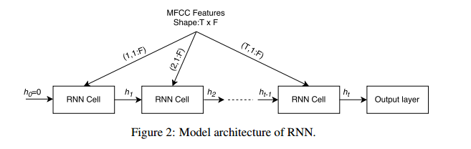
III. Neural Network Architectures for KWS
RNN
superior performance in many sequence modeling tasks, especially speech recognition, language modeling, translation
temporal relation
long-term dependencies using gate machinisam
RNN Cell could be LSTM cell, gated recurrent unit GRU
less parameters than CNN
normalized
Notes:
1. 批归一化问题batch normalization in CNNs

Slide 11
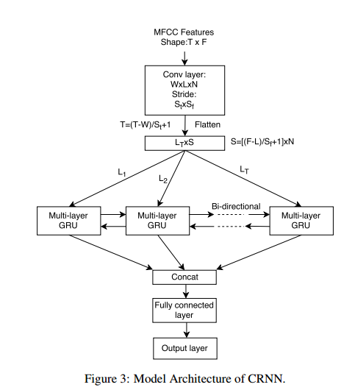
III. Neural Network Architectures for KWS
CRNN
A hybrid of CNN and RNN
exploit the local temporal/spatial correlation
starts with a convolution layer
followed by an RNN
GRU used as RNN based
a dense full-connected layer
Notes:
1. SIMD single instruction multiple data 同时读取数据，一次执行
2. 乘法和加法

Slide 12
III. Neural Network Architectures for KWS
DS-CNN
DS-CNN first convolve each channel in the input feature map with a separate 2-D filter
decomposing the 3D into 2D convolution
average pooling followed by a full-connected layer
see also paper, <Xception Deep Learning with depthwise separable convolutions >
Notes:
1. 有一篇最新的文章，2016 Xception Deep Learning with depthwise separable convolutions

Slide 13
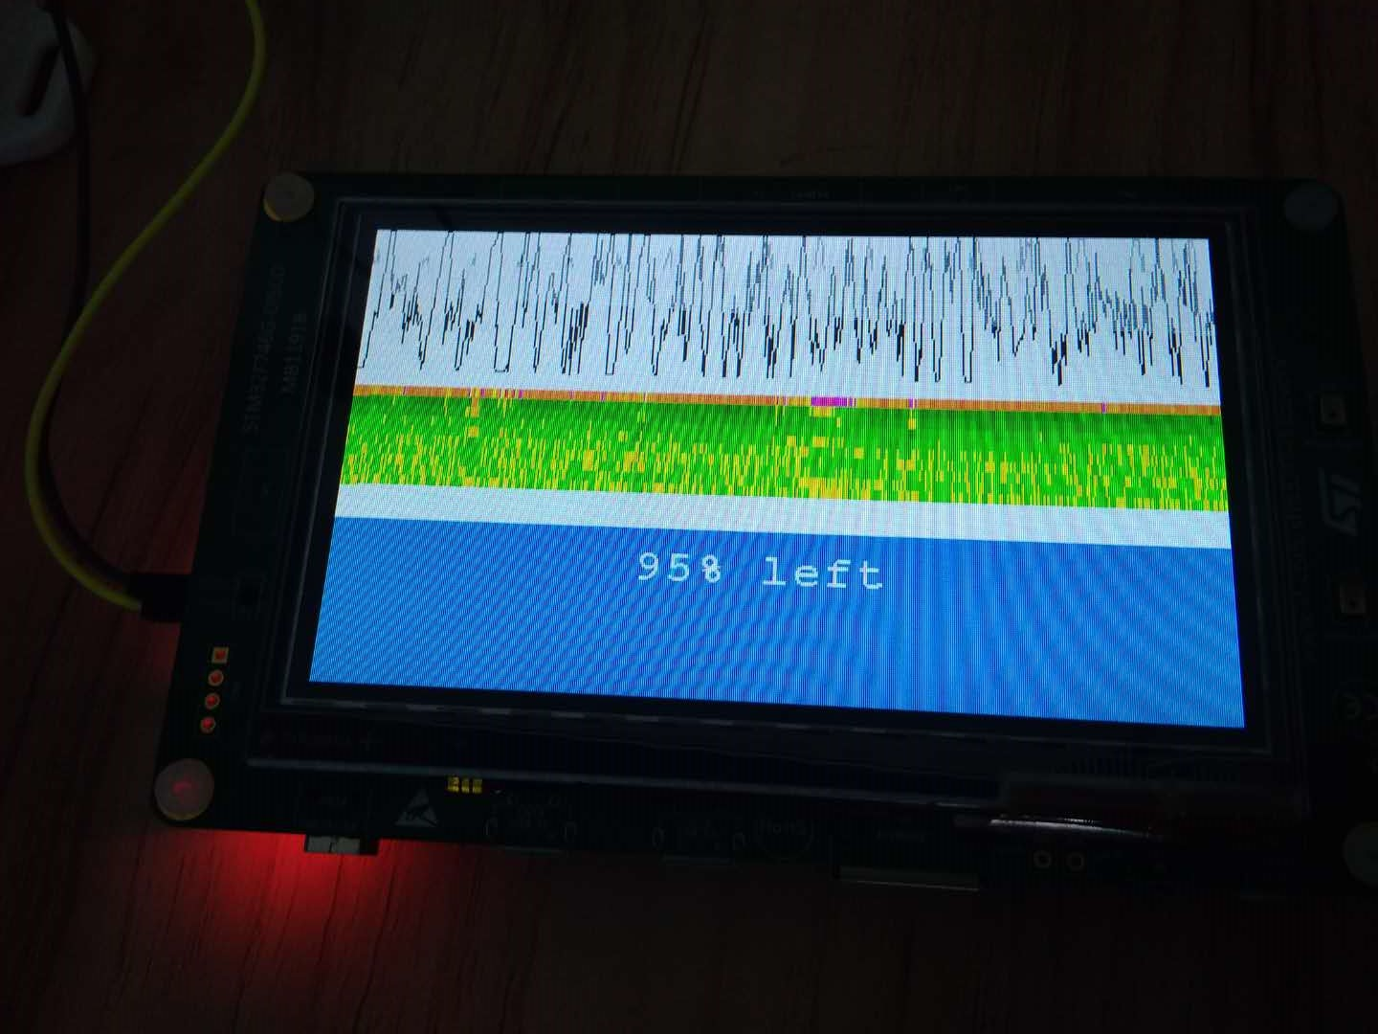
IV. Experiments and Results
Google speech command dataset
64K 1-second long audio clips of 30words
thousands of different people
each clip consisting only one keyword
NN model
classify the incoming audio into one of 10 keywords
Data split into
training 80%
validation 10%
test 10%
Google Tensorflow framework
cross-entroy loss and Adam optimizer
a batch size 100
20k iterations
learning rate of 5*10⁻⁴,
traning data
is augmented with backgroud noise and random time shift of up to 100ms
Notes:
1. 实验采用谷歌的tensorflow，数据集也是谷歌的，在一个STM32F746的板子上运行起来。
2. 对输入的音频数据进行分类，分成10个关键词
3. 数据分为80%用于训练，10%用于验证，10%用于测试，
4. tensor框架，交叉熵，adam优化，批大小为100, 迭代次数20k, 学习率为5*10-4
5. 训练数据可以由背景噪音增强，随机时间偏移到100ms。

Slide 14
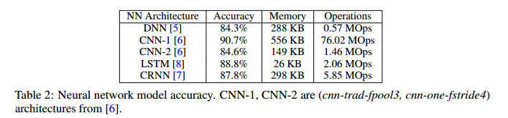
IV. Experiments and Results
experiments 1
40 MFCC features extracted from a speech frame of length 40ms with a stride of 20ms
1960(49*40)features for 1 second of audio
DNN
not the best accurary and memory intensive
less number of operations/inference
suit well to limited compute capacity
CNN
higher accurary than DNN
cost larger number of operations and memory requirement
LSTM and CRNN
balance memory and operations and accurary
Notes:
1. 实验1是40MFCC特征，从语音帧长度为40ms，有20ms的带宽；
2. 每秒中有1960个特征；
3. DNN，不是最好的精度或内存敏感，比较少的操作推理，适合计算容量；
4. CNN，比DNN的精度高，花费更多的操作和内存需求；
5. LSTM和CRNN两个模型，平衡内存，操作和精度；
6. 几种NN架构，在同一精度水平情况下，各个模型和操作的需求情况。

Slide 15
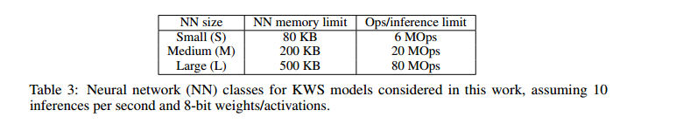
IV. Experiments and Results
Classifying Neural Networks for KWS based on Resource Requirements
two important considerations for
memory footprint
execution time
Derive three sets of constraints for the neural networks
small
medium
large
Notes:
1. 按照资源需求来分来NN类型；
2. 内存消耗和执行时间（需求的操作数量），KWS在单片机上运行的两种重要考虑因素；
3. 内存和计算，还包括资源，操作，IO，网络通信等；
4. 延伸三类神经网络；

Slide 16
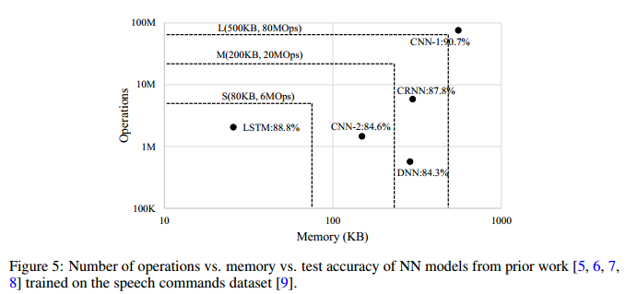
IV. Experiments and Results
Resource Constrained Neural Network Architecture Exploration
target: high accuracy, small memory footprint and lower number of computation
The following figure show the actual accuracy, memory and ops of various model
Notes:
1. 理想的模型应该有比较搞的精度，小的内存占用和计算数
2. 除了LSTM之外，其他模型都是需要比较大的内存和计算资源的，
3. 从实验的思路来说，主要看CNN,RNN,DNN,LSTM对资源的要求。
1. 对于输入信号来说，特征被提取出来是后是一个TXF的特征矩阵，特征数量影响到模型的大小，运算操作数量和精度，
2. 特征提取步骤的关键参数，影响模型。
3. MFCC的数量又影响的全连接和循环层的权重值；
4. 怎么影响的，一定要举例来说明。

Slide 17
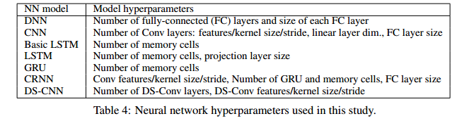
IV. Experiments and Results
Resource Constrained Neural Network Architecture Exploration-2
comparation of DNN,CNN LSTM, GRU, CRNN, DS-CNN hyperparameters
Notes:
1. DS-CNN对比之前的NN结构的超参数，
2. 总结这些NN结构在不同问题规模下的效果总结

Slide 18
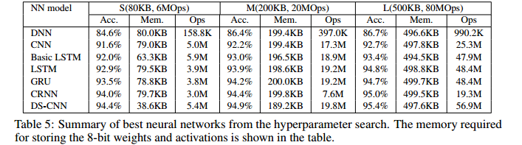
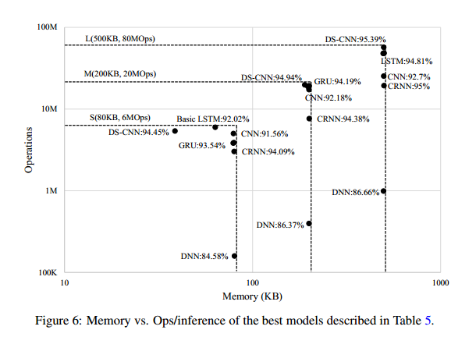
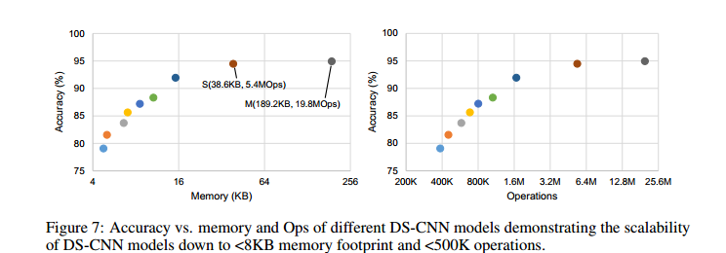
IV. Experiments and Results
Notes:
1. 表5，最好神经网络来自超参数的搜索的总结。存储8位权值和激活函数
2. 最好模型的存储和操作，推理的比较
3. DS-CNN的精度，内存，操作的比较

Slide 19
IV. Experiments and Results
Neural Network Quantization
trained with floating point weights and activations
quantized into integers during inference without any loss of performance
Qm.n format, a fixed point number format
Q1.14 , 1 integer bit and 14 fractional bits
Q format used in hardware that does not have a floating-point unit
Quantization flow
value convertion
weight are quantize to 8-bit one layer
Notes:
1. 之前的研究都是浮点权值，可以很好地运行神经网络，精度损失可以最小
2. 但是微控制器具有有限的内存，当然DSP也可以用于浮点运算，如果大量的浮点运算还是很难胜任的
3. 如果要在微控制器上部署，就需要将32位的浮点运算转换为8位的定点运算，减少模型的尺寸。
4. 定点运算比浮点运算快，这也是部署需要量化模型的一个原因

Slide 20
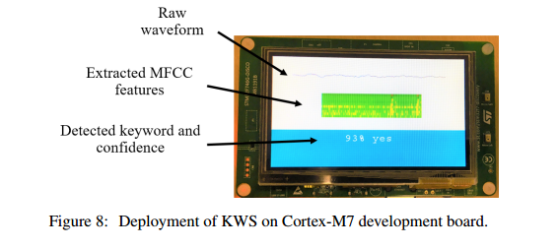
IV. Experiments and Results
KWS for microcontrollers
deploy the KWs application on Cortex-M7 based STM32F746G-DISCO development board using CMSIS-NN kernels
each inference, including memory copying, MFCC feature extraction and DNN exectution ,takes about 12ms
microcontroller can be put into wait-for-interrupt mode for the remaining time for power saving.
KWS application occupies ~70KB memory, including ~66KB for weight, ~1KB for activation and ~2KB for audio I/O and MFCC features
Notes:
1. 运行在微控制器上的关键词检测
2. 在STM32F746G-DISCO 开发板上，使用基于CMSIS-NN cortex微控制器软件接口标准下的神经网络框架

Slide 21
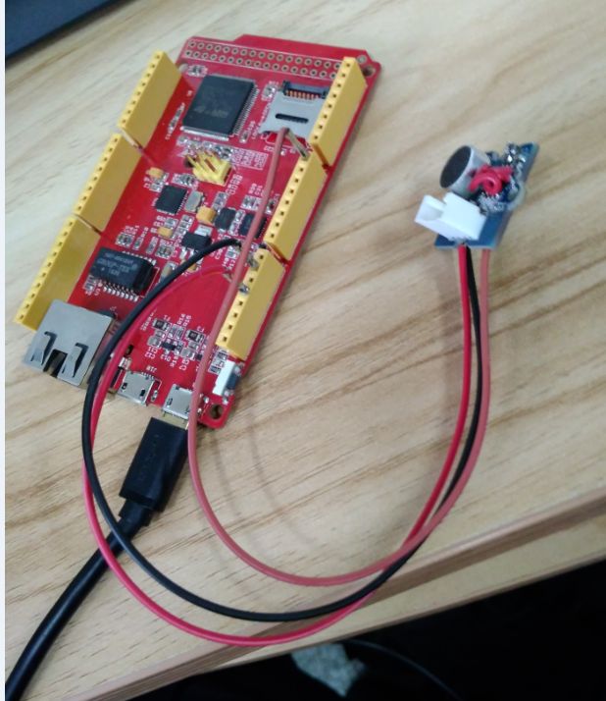
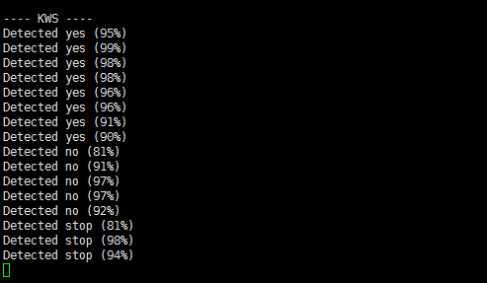
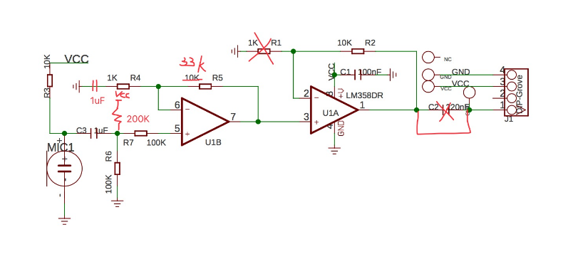
IV. Experiments and Results
KWS for microcontrollers
some change of op external circuit for better performance on F407
Notes:
1. 运行在微控制器上的关键词检测
2. 在STM32F746G-DISCO 开发板上，使用基于CMSIS-NN cortex微控制器软件接口标准下的神经网络框架

Slide 22
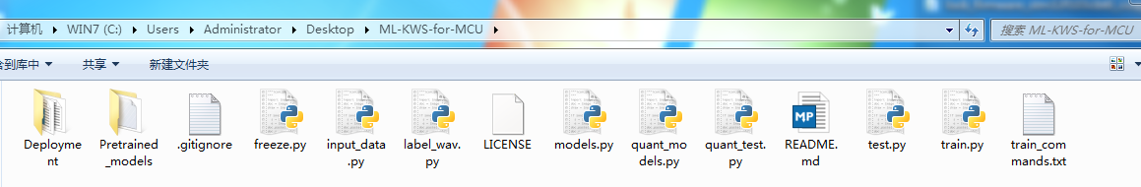
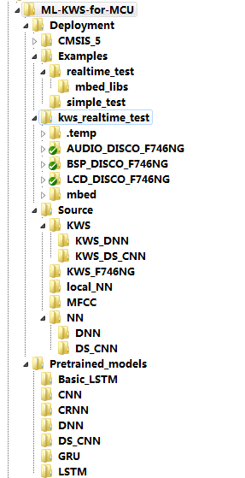
IV. code and other useful material
Code folder
{"Silence",
"Unknown",
"yes",
"no",
"up",
"down",
"left",
"right",
"on",
"off",
"stop",
"go"};
Notes:
1. ML-KWS-for-MCU 目录下，包括train.py，用于生成各类模型从CNN,CRNN,DNN,LSTM等模型的参数；

Slide 23
V. Conclusion
Hardware optimized neural network architecture
key to get efficient results on memory and compute contrained microcontrollers.
trained various neural network architectures for keyword spotting
CNN,DNN,RNN,CRNN,LSTM etc
quantized representative
32bit floating-point into 8bit fixed point versions
models can easily be quantized for deployment
without any loss in accuracy
even without retraining
a new KWS model
using depthwise separable convolution layer, inspired from MobileNet
we derived three sets of memory/compute constraints
Based on typical microcontroller systems,
or the neural networks and performed resource constrained
Notes:
1. 硬件优化的神经网络是在内存和计算受限的微控制器上得到有效的效果的关键；
2. 训练在文献中各类NN模型用于KWS，对google数据集测试来比较他们的精度和内存需求，包括每条推理的操作数，，微控制器的部署等；
3. 量化训练32位的浮点KWS模型到8位浮点版本，容易部署，不会损失精度，不会重新训练；
4. 进一步训练新的KWS模型，使用深度分类卷积层；
5. 基于典型的微控制器系统，延伸了三种神经网络内存计算限制的三个集，探索神经网络发现最好的网络，达到最好的精度；

Slide 24
2018
THANK YOU

